Slide 1
Tutorial 06
Working with Tables and Columns

Slide 2
Objectives
Explore the structure of a web table
Create table heading and data cells
Apply CSS styles to a table
Create cells that span multiple rows and columns
Add a caption to a table

Slide 3
Objectives (continued)
Create row and column groups
Apply styles to row and column groups
Display page elements in table form
Create a multi-column layout

Slide 4
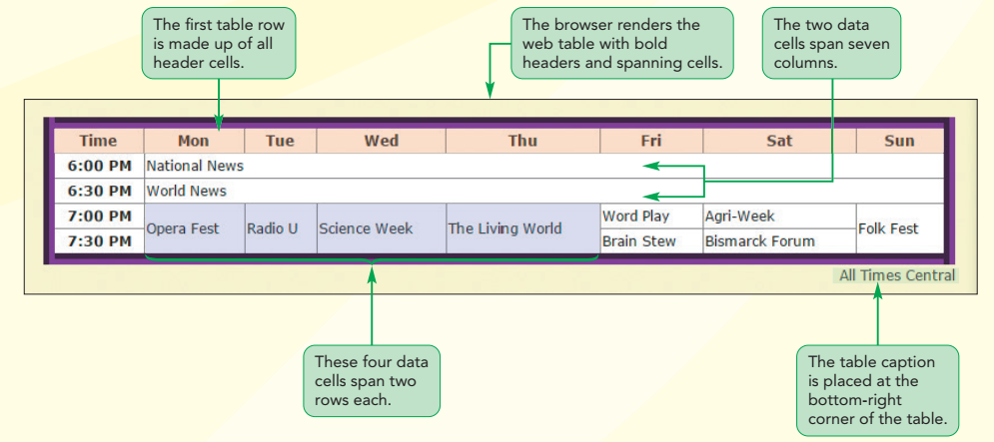
Structure of a Web Table

Slide 5
Introducing Web Tables
Web table
  HTML structure that consists of multiple table rows
  Each table row contains one or more table cells
  The cells themselves can contain additional HTML elements
  Effective tool for organizing and classifying web page content
  Consists of a table element

Slide 6
Marking Tables and Table Rows
A table element contains a collection of table rows marked using the tr (table row) element
A table contains cells within each row
Size of a table is defined by
  Number of table rows
  Number of cells within rows

Slide 7
Marking Tables and Table Rows (continued 1)
General structure of a web table:
  <table>
  <tr>
  table cells
  </tr>
  <tr>
  table cells
  </tr>
  …
  </table>

Slide 8
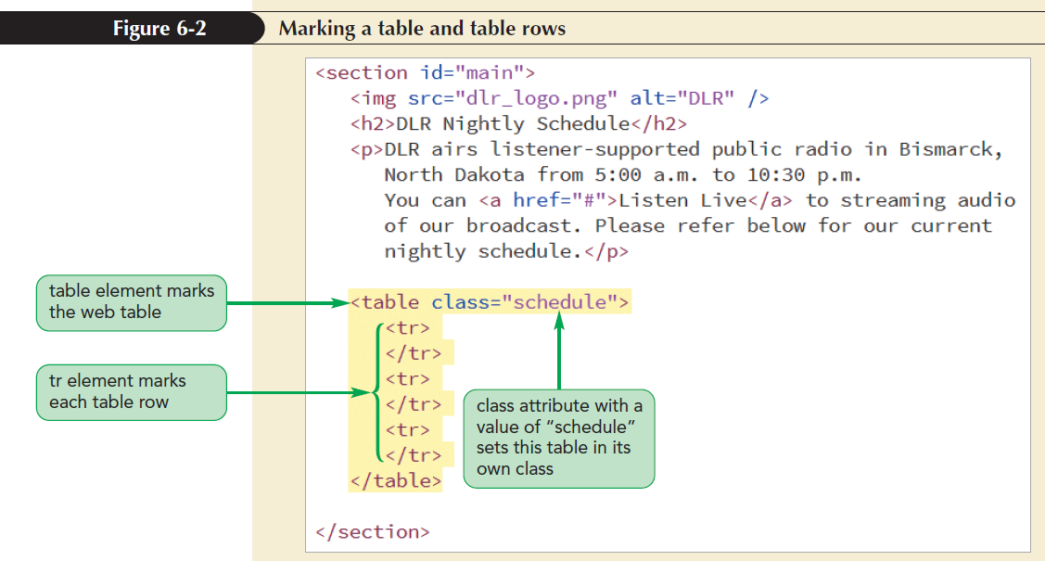
Marking Tables and Table Rows (continued 2)

Slide 9
Marking Table Headings and Table Data
Web tables support two types of table cells
  Header cells
    Contains content placed at the top of a column or beginning of a row
    By default, displays text in bold and centers text horizontally
    Marked using the th element
  Data cells
    Contains content within columns or rows
    By default, displays text as unformatted text and is aligned to the left within the cell
    Marked using the td element

Slide 10
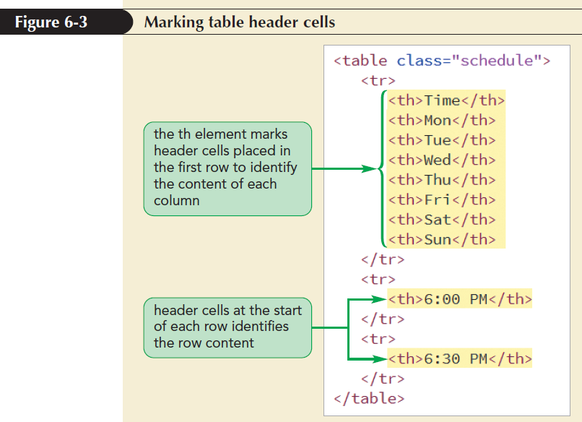
Marking Table Headings and Table Data (continued 1)

Slide 11
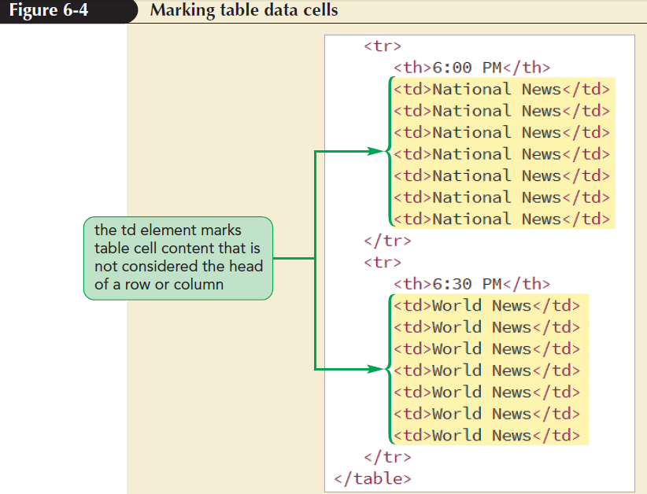
Marking Table Headings and Table Data (continued 2)

Slide 12
Adding Table Borders with CSS
The CSS border property is used to add borders to any part of a web table
Borders need not be of the same style
Two style choices for borders
  Separate borders
  Collapsed borders

Slide 13
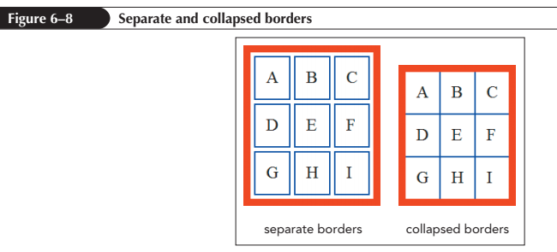
Adding Table Borders with CSS (continued 1)

Slide 14
Adding Table Borders with CSS (continued 2)
To choose between separate or collapsed borders model apply the following property to the table element:
    border-collapse: type;
  where type is either separate or collapse
The separate borders model sets the spacing between borders using:
    border-spacing: value
    where value is in CSS units of measure

Slide 15
Adding Table Borders with CSS (continued 3)
The collapsed borders model
  Borders from adjacent elements are merged to form a single border
  Borders are joined to combine their features
  Combining adjacent borders with different widths, styles, or colors is complicated

Slide 16
Adding Table Borders with CSS (continued 4)
Five rules to reconcile the differences between adjacent borders
  If either border has a style of hidden, the collapsed border is hidden
  Border style of none is overridden by another border style
  The style of wider border takes priority over the narrower border if neither border is hidden

Slide 17
Adding Table Borders with CSS (continued 5)
Five rules (continued)
  Double borders have higher precedence followed by solid, dashed, ridge, outset, groove and inset
  If borders differ only in color, precedence is given to borders

Slide 18
Adding Table Borders with CSS (continued 6)
Precedence to borders in decreasing order
  Borders around individual table cells
  Borders for table rows
  Borders for row groups
  Borders for columns
  Borders for column groups
  Borders around the entire table

Slide 19
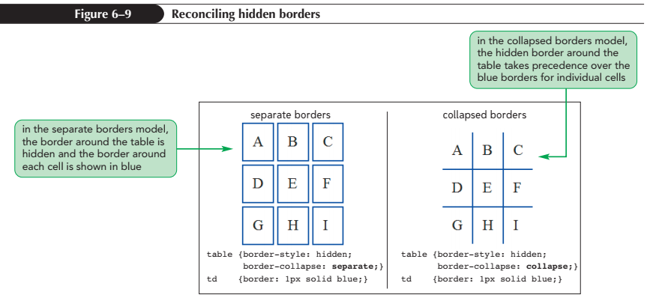
Adding Table Borders with CSS (continued 7)

Slide 20
Spanning Rows and Columns
Spanning cells
  Single cell that occupies more than one cell row and/or column
  Created by adding rowspan and/or colspan attributes to td or th elements
  Spanning starts in the cell with rowspan or colspan attributes and covers the cells in the right and below the initial cell

Slide 21
Spanning Rows and Columns (continued 1)
rowspan=“rows”
where rows is the number of rows that the cell occupies
colspan = “cols”
where cols is the number of columns that the cell occupies

Slide 22
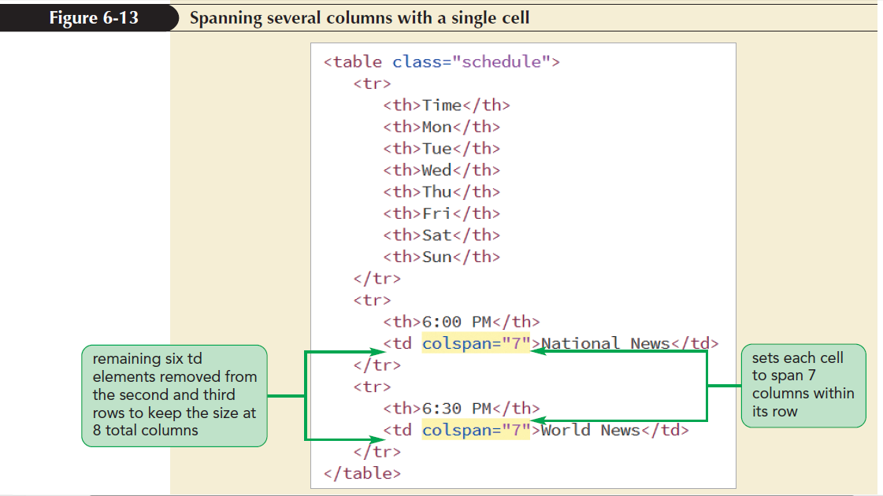
Spanning Rows and Columns (continued 2)

Slide 23
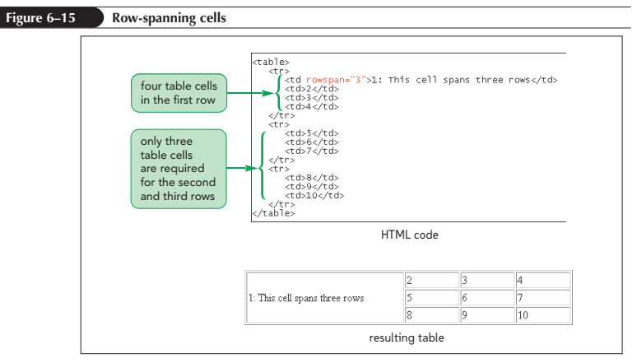
Spanning Rows and Columns (continued 3)

Slide 24
Creating a Table Caption
Marked using the caption element
<caption>content</caption>
where content is the content contained within the caption
Listed immediately after the <table> tag
Only one caption is allowed per web table
Inherits the text styles associated with the table

Slide 25
Creating a Table Caption (continued 1)
By default, captions are placed above the tables
To specify the location, use the caption-side property
caption-side: position;
where position is either top or bottom

Slide 26
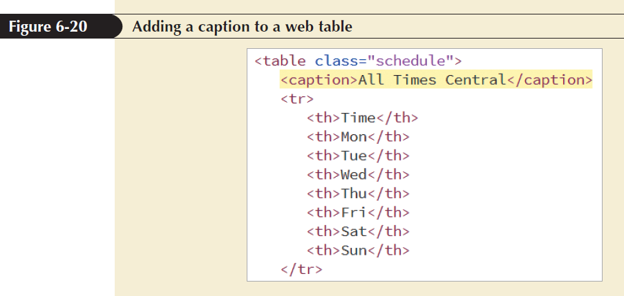
Creating a Table Caption (continued 2)

Slide 27
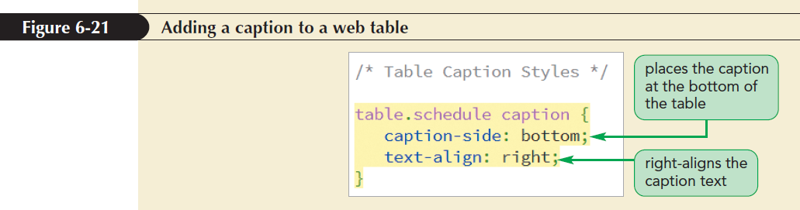
Creating a Table Caption (continued 3)

Slide 28
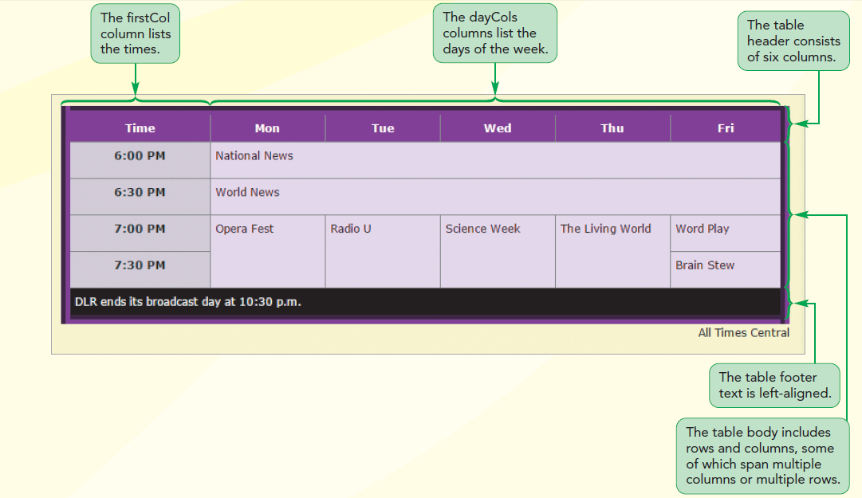
Rows and Column Groups

Slide 29
Creating Row Groups
Row groups contain specific table information
Allows the creation of different styles for groups of rows
HTML supports three row groups
  Rows that belong to the table head
    Marked using thead element
  Rows that belong to the table footer
    Marked using tfoot element
  Rows that belong to the table body
    Marked using tbody element

Slide 30
Creating Row Groups (continued 1)
The general structure of a web table divided into row groups
  <table>
  <thead>table rows</thead>
  <tfoot>table rows</tfoot>
  <tbody>table rows</tbody>
  </table>
Only one thead and tfoot element is allowed per table

Slide 31
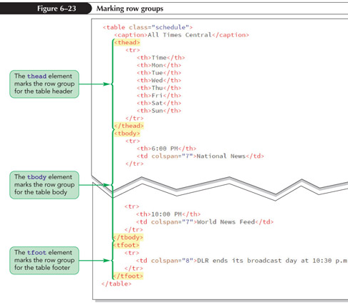
Creating Row Groups (continued 2)

Slide 32
Creating Column Groups
Columns are determined implicitly based on the number of cells within the table rows
Columns can be referenced using the colgroup element

Slide 33
Creating Column Groups
(continued 1)
Example of colgroup element:
<table>
<colgroup>
columns
</colgroup>
table rows
</table>
where columns are the individual columns defined within the group and table rows
are the table rows

Slide 34
Creating Column Groups
(continued 2)
The columns within the colgroup element are identified by the following col element:
<col span="value" />
where value is the number of columns spanned by the col element
If no span attribute is included, the col element references a single column

Slide 35
Creating Column Groups
(continued 3)
Once columns are defined using the colgroup and col elements individual columns can be identified
Use the id and/or class attributes for the purposes of applying CSS styles to specific columns

Slide 36
Creating Column Groups
(continued 4)
Columns and column groups accept only CSS style properties to modify
  Column borders
  Background
  Width
  Visibility

Slide 37
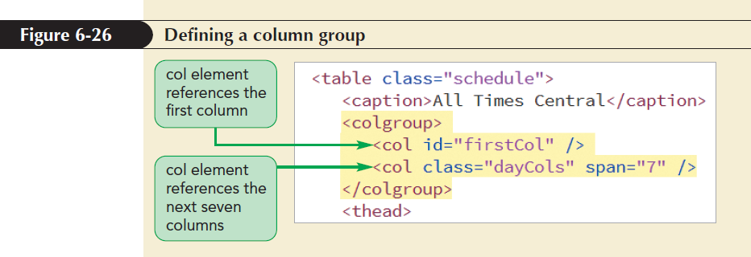
Creating Column Groups
(continued 5)

Slide 38
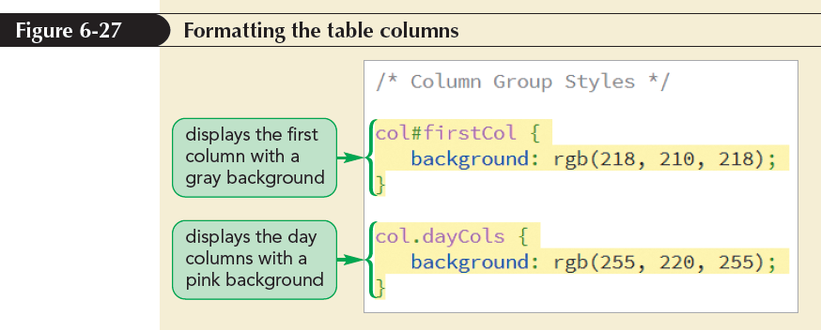
Creating Column Groups
(continued 6)

Slide 39
Exploring CSS Styles and Web Tables
Levels of precedence in the table styles in decreasing order
  Table cells
  Rows
  Row groups
  Columns
  Column groups
  Table

Slide 40
Working with Width and Height
By default, browsers attempt to fit more content in each column before wrapping the cell text
Extra space is divided equally among columns if the width of a table is larger than its individual columns
Column widths are set using the width property

Slide 41
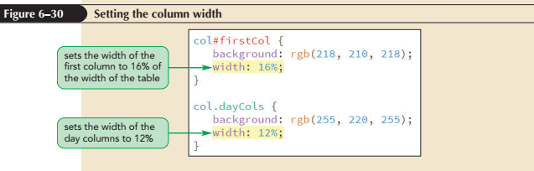
Working with Width and Height
(continued 1)

Slide 42
Working with Width and Height
(continued 2)
The height of each row is based on the height of the tallest cell
A uniform row height is defined by applying the height style to table rows within each row group
The vertical-align property is used to move the cell text

Slide 43
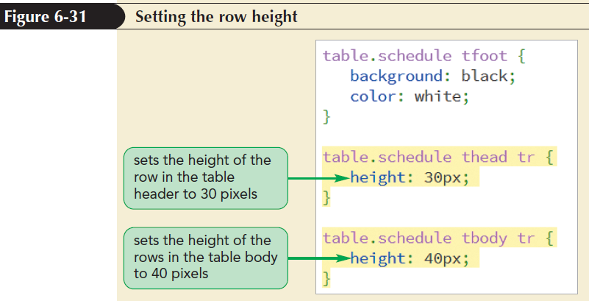
Working with Width and Height
(continued 3)

Slide 44
Applying Table Styles to Other Page Elements
Can use the CSS display property to apply a table layout to other HTML elements
  Paragraphs, block quotes, lists

Slide 45
Applying Table Styles to Other Page Elements (continued 1)
Display Style | Equivalent HTML Element
display: table; | table (treated as a block-level element)
display: table-inline; | table (treated as an inline element)
display: table-row; | tr
display: table-row-group; | tbody
display: table-header-group; | thead
display: table-footer-group; | tfoot
display: table-column; | col
display: table-column-group; | colgroup
display: table-cell; | td or th
display: table-caption; | caption

Slide 46
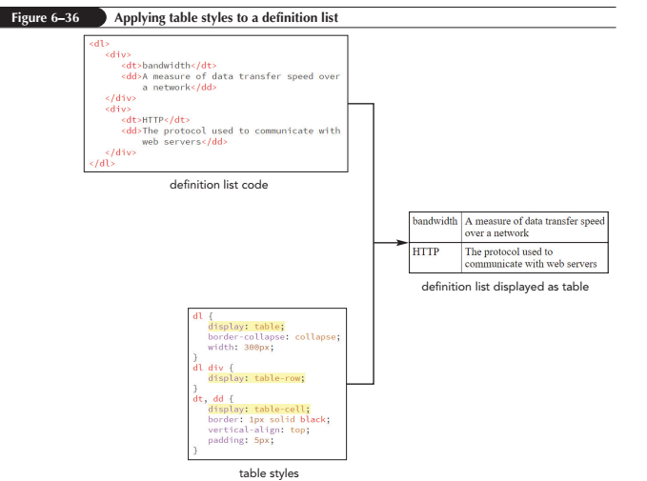
Applying Table Styles to Other Page Elements (continued 2)

Slide 47
Tables and Responsive Design
Tables do not scale well to mobile devices
Problems faced by users to view a table in a mobile device
  Table is too small to read
  Table does not fit the visual viewport
  Table columns are too narrow to read the cell content

Slide 48
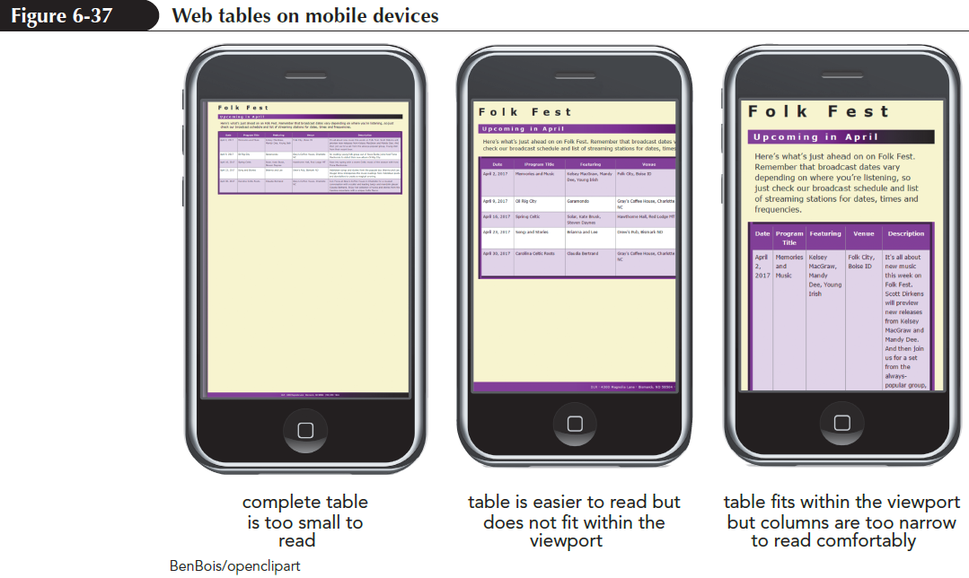
Tables and Responsive Design
(continued 1)

Slide 49
Tables and Responsive Design
(continued 2)
A new layout of table data for mobile screens is required
Several table columns are reduced to two:
  One column containing all data labels
  Second column containing data associated with each label

Slide 50
Tables and Responsive Design
(continued 3)
To create a responsive web table, add the text of data labels as attributes of all td elements in the table body
Store data labels using a data attribute
General format of a data attribute is
data-text=“value”
where text is the name of the data attribute and value is its value

Slide 51
Tables and Responsive Design
(continued 4)
Data attributes use names specific to the function it is used for
For example, the following code uses a data attribute named data-label to store the text of the labels associated with the data cell:
<td data-label=“Date”>April 2, 2021</td>

Slide 52
Tables and Responsive Design
(continued 5)
The result is a list of data cells that are aligned as block elements
Within each block element, the data label is followed by the data cell content
The goal is to transform table with multiple columns into two-column layout

Slide 53
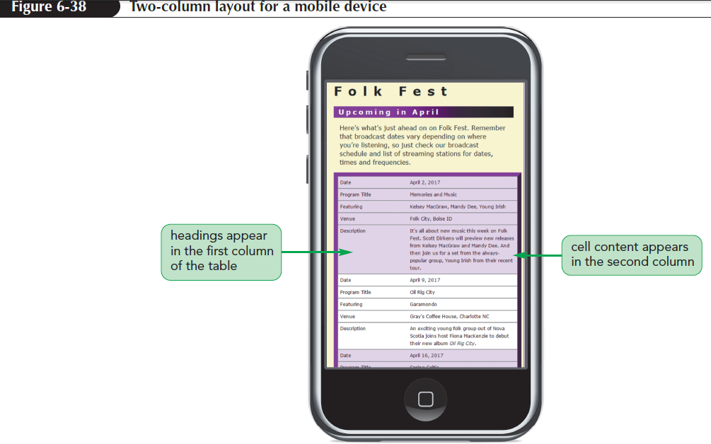
Tables and Responsive Design
(continued 6)

Slide 54
Designing a Column Layout
Column layout enables display of content side-by-side in a page
Layouts that use float elements or flexboxes differ from column layout
  Single element can flow from one column to the next
  Flow of content adjusts to match the page width

Slide 55
Setting the Number of Columns
Size of a column is set using the column-count property
column-count: value;
where value is the number of columns in the layout
Browser extensions are included to ensure cross-browser compatibility

Slide 56
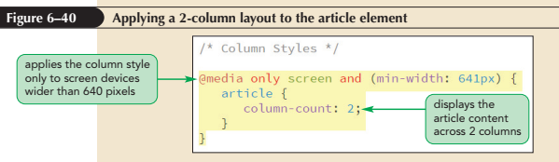
Setting the Number of Columns
(continued)

Slide 57
Defining Column Widths and Gaps
Columns are laid out evenly across the width of the parent element by default
To set the column width, use the column-width property
column-width: size;
where size is the minimum width of the column
Column width acts like the basis value for items in a flexbox

Slide 58
Defining Column Widths and Gaps
(continued 1)
The column-width and column-count properties are combined to form shorthand columns property
columns: width count;
The default gap between columns is 1em
To set a different gap size, use the column-gap property
column-gap: size;
where size is the width of the gap

Slide 59
Defining Column Widths and Gaps
(continued 2)
Another way to separate columns is with a graphic dividing line created using the column-rule property
column-rule: border;
where border defines the style of dividing line
The column-rule property can be broken into individual properties like column-rule-width, column-rule-style, and column-rule-color

Slide 60
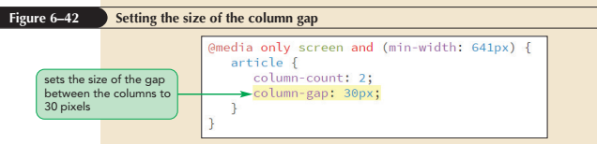
Defining Column Widths and Gaps
(continued 3)

Slide 61
Managing Column Breaks
The size of column orphans is controlled using the orphans property
orphans: value;
where value is the minimum number of lines stranded before a column break
The size of column widows is controlled using the widows property
widows: value;
where value is the minimum number of lines placed after a column break

Slide 62
Managing Column Breaks
(continued 1)
Other properties to define column breaks
break-before: type;
break-after: type;
where type is one of the following:
auto (browser automatically sets column break)
always (to always place a column break)
avoid (to avoid placing a column break)

Slide 63
Managing Column Breaks
(continued 2)
To control placement of column breaks within an element, use the property
break-inside: type;
where type is either auto or avoid

Slide 64
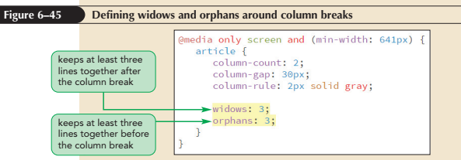
Managing Column Breaks
(continued 3)

Slide 65
Spanning Cell Columns
To span cell columns, use the column-span property
column-span: span;
where span is either none to prevent spanning or all to enable the content to span across all the columns

Slide 66
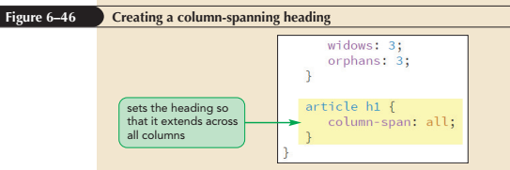
Spanning Cell Columns (continued)

